Slide 1


Nanoshells under pressure
Pressure gauges with a golden layer
21 July 2012

Slide 2
Overview
Nanoshells
DAC
Mie & Hybridization theory
Nanoshells (NS) under pressure
Coated Nanoshells (CNS)
Experiments & outview

Slide 3
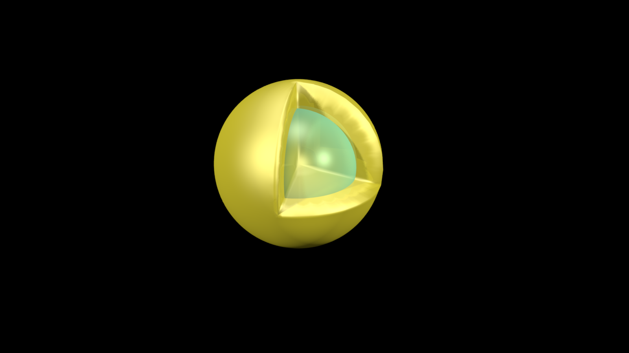
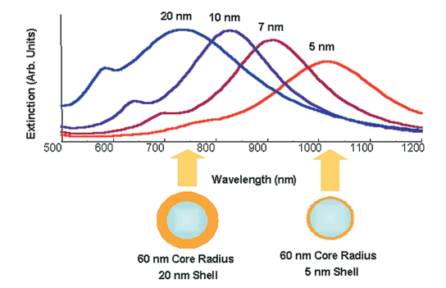
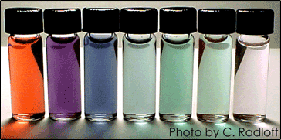
Nanoshells:
Gifts in a golden wrapper
Dielectric core & metallic shell
Tunable
Au
SiO₂
Halas N., Optics & Photonics News, p. 26 (August 2002)

Slide 4
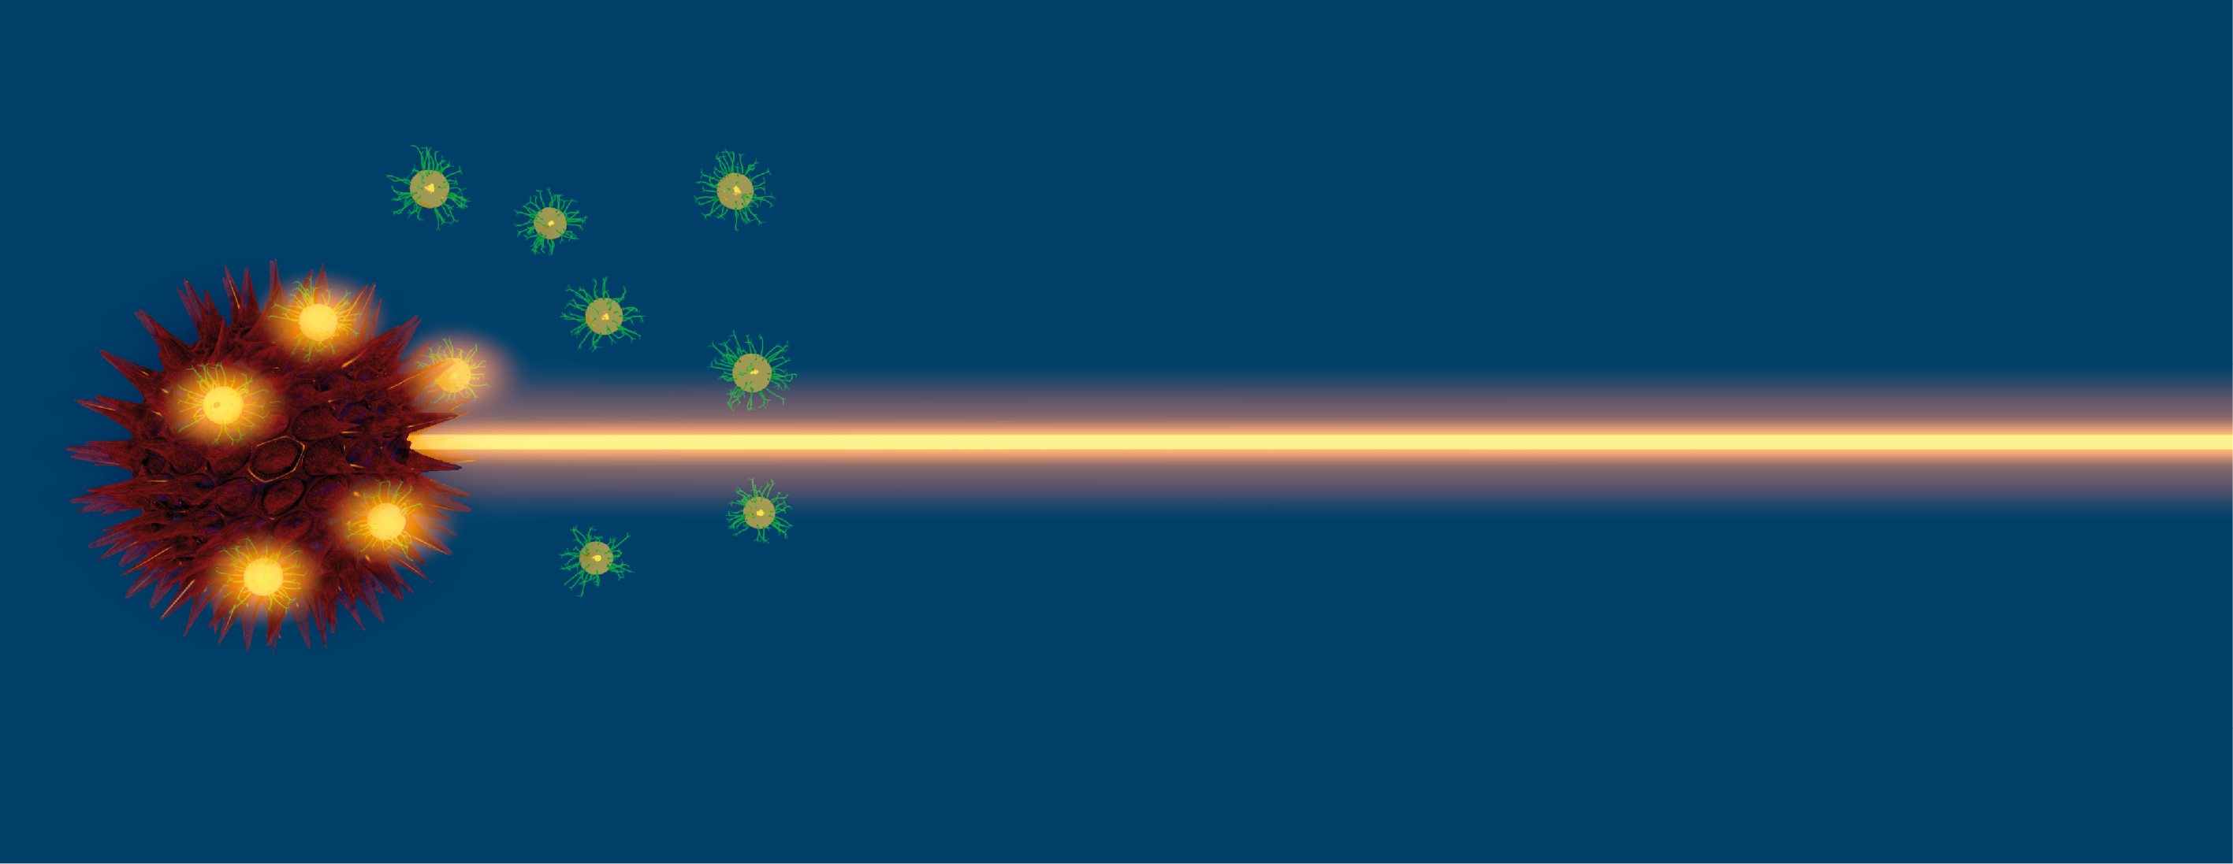
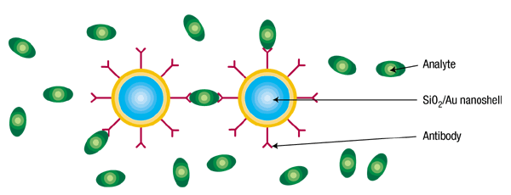
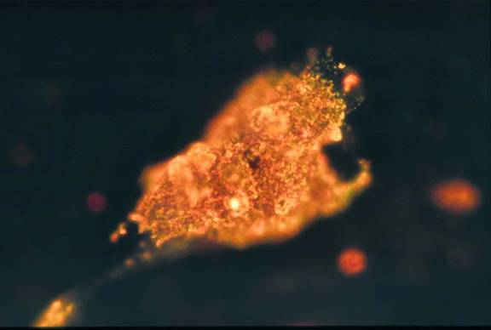
Nanoshells:
Gifts in a golden wrapper
Applications
  Biosensing
  Cancer ablation
  Targeted medication
  Plasmonics
  …

Slide 5
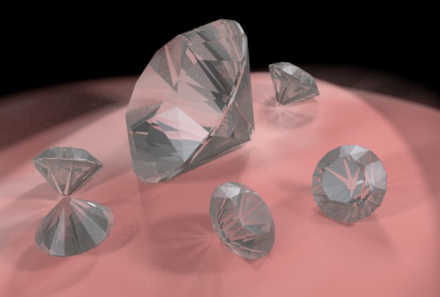


Diamond Anvil Cell (DAC)
$PA=F=P^{′}A^{′}$
Small pressure on large surface $⇒Large pressure on small surface$
DAC uses diamonds:
Table
Culet
Notes:
Omdat Diamanten hard en onsamendrukbaar zijn. En omdat diamanten doorzichtig zijn, waardoor optische metingen mogelijk zijn.

Slide 6
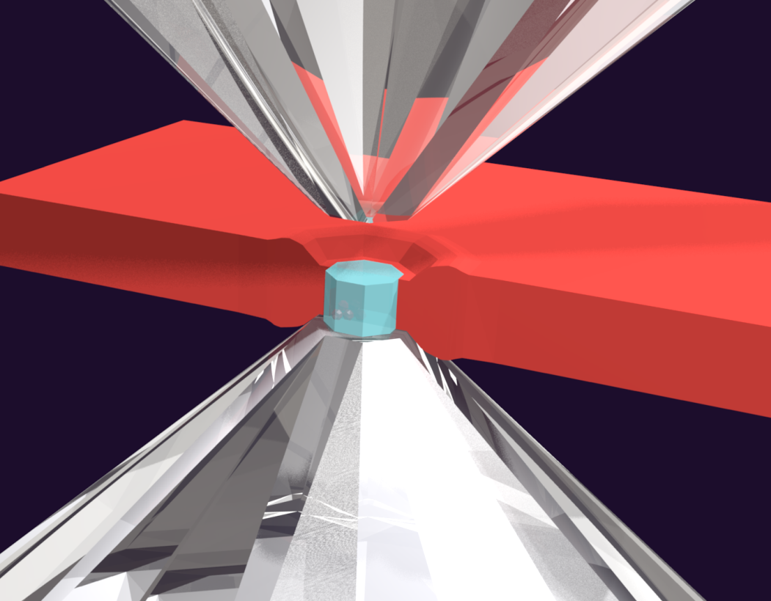
Diamond Anvil Cell (DAC)
Create high pressures in between to diamonds
In between the
diamonds there is a
pressure medium:
  Helium
  Hydrogen
  Neon
  …

Slide 7
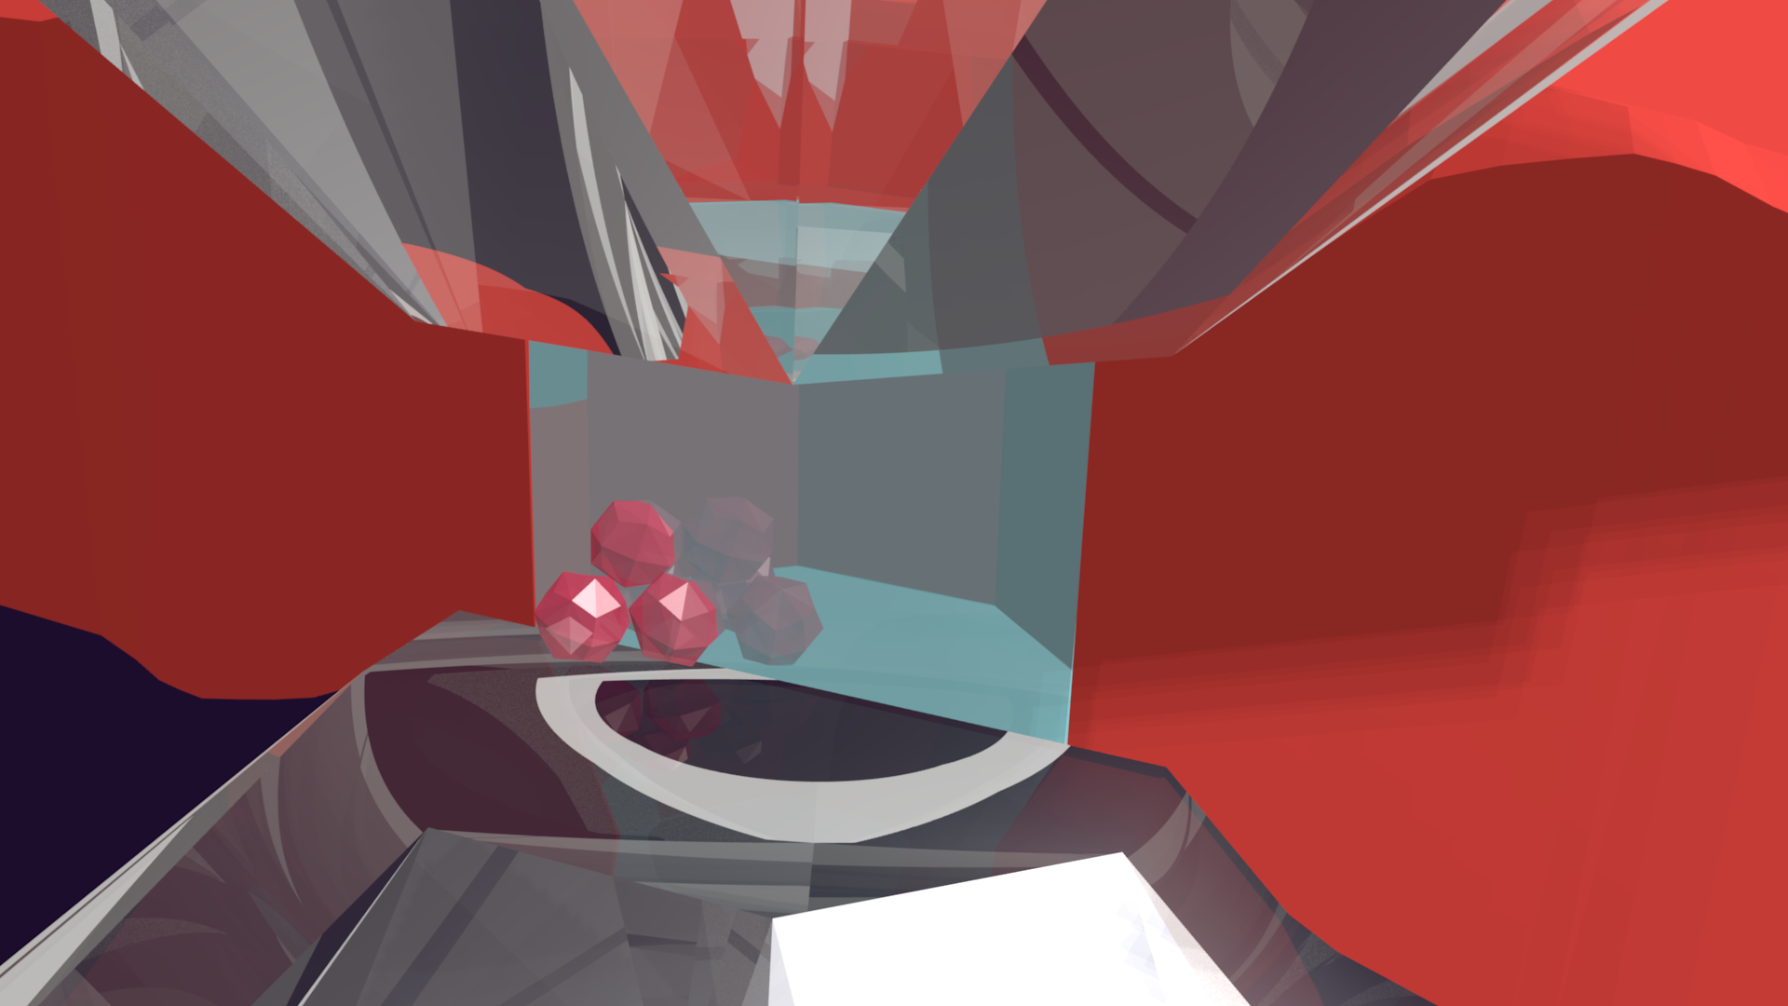
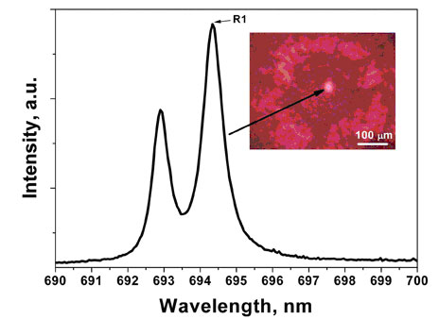
Rubies as pressure sensor
Use the spectrum of rubies to measure the pressure
The R₁ and R₂ lines will shift under pressure
Needs to be
calibrated
APS: http://www.aps.anl.gov/News/APS_News/Content/APS_NEWS_20080311B.php

Slide 8
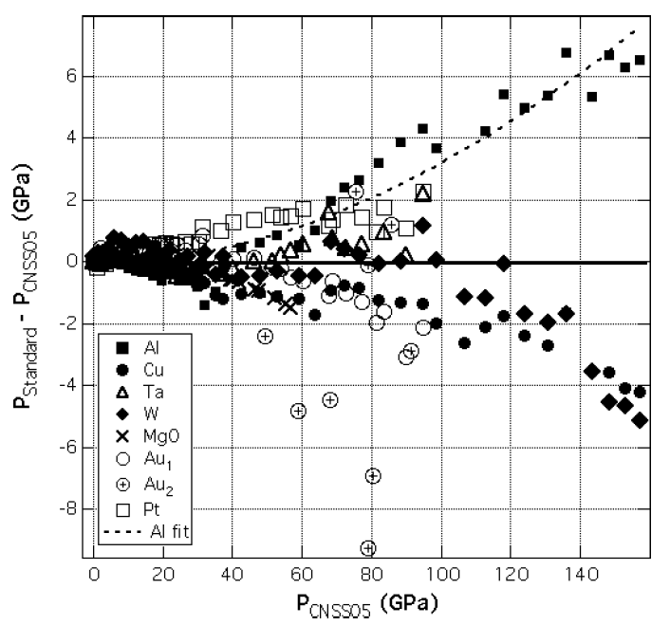
Rubies as pressure sensor
Unfortunatly the calibration is not perfect
Interference with
diamond resonances
Silvera et. al. Phys. stat. sol. (b) 1, 460-467 (2007)
Notes:
Men kalibreert de robijnen via metalen (waarbij men via de roosterparameter zeer nauwkeurig de druk kan bepalen). Echter, zoals uit de figuur blijkt is de kalibratie afhankelijk van het gekozen metaal, wat eigenlijk wil zeggen dat er toch een onnauwkeurigheid zit op de drukmeting

Slide 9
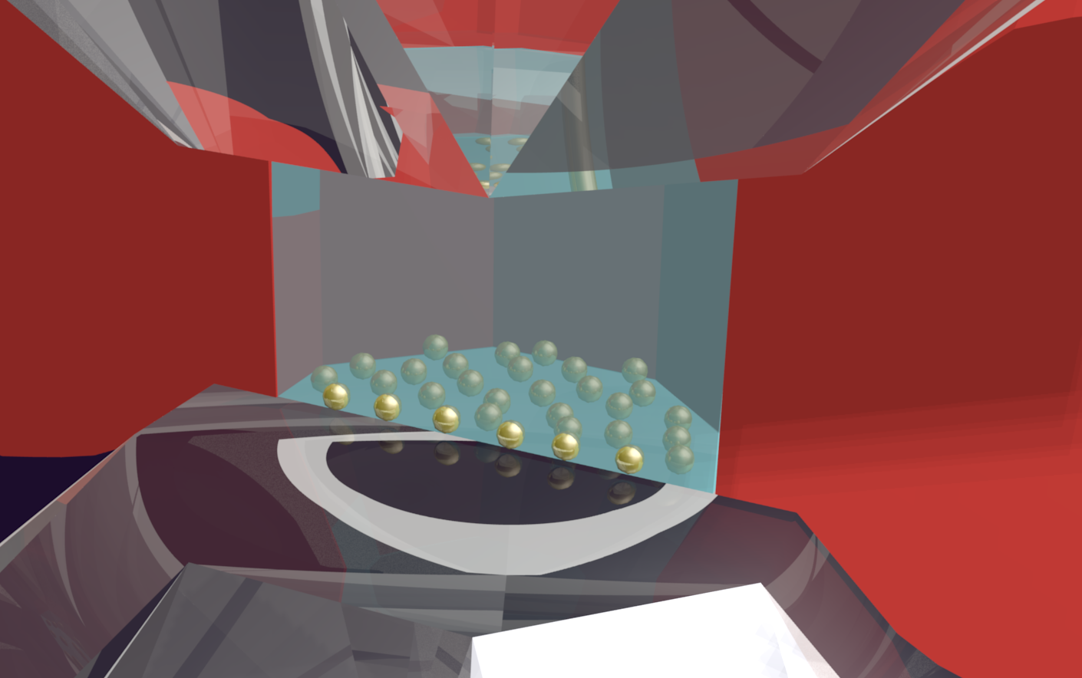
Nanoshells as pressure gauge
Use the optical response of nanoshells in stead of rubies
Why?
  NS are smaller
  Tunable
  …
Notes:
Extra’s: voor opwarming, als extra biosensor, we kunnen ze mixen, …

Slide 10
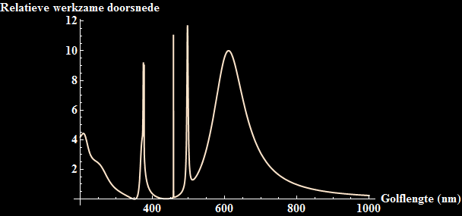
Mie-theory
We use Mie-theory to calculate the spectrum of nanoshells:
R_{c} = 60 nm
R_{s} = 75 nm

Slide 11
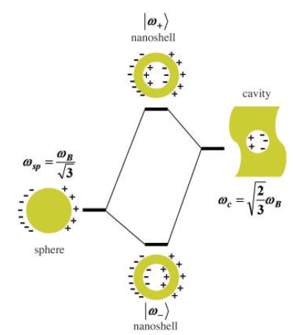
Hybridization model
Nanoshells =
cavity +
sphere
Solve the Lagrangian of the electron sea which is depicted as an incompresible fluid.
Prodan, et. al., Science, 302, 419 (2003)

Slide 12

Mie vs. Hybridization
Mie solves exactly for given dielectric function, but needs further numerical manipulation.
Hybridization is not exact, but gives
analytical solutions:

Slide 13
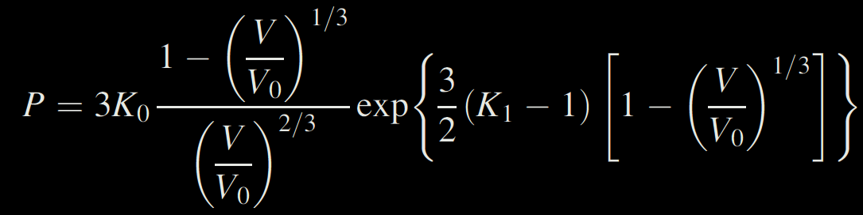
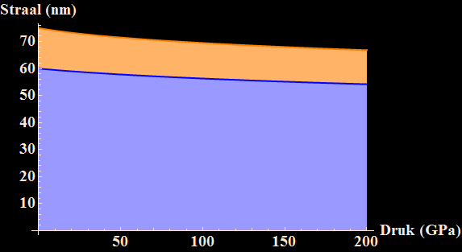
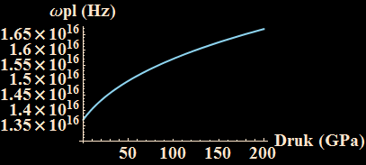
Nanoshells under pressure
Compression of NS
    Radii change: R_{c}(P) and R_{s}(P)
    Electron density changes n_{e}(P)
Vinet equation: J. Geophys. Res. 92, 9319 (1987)
Notes:
Vinet equation

Slide 14
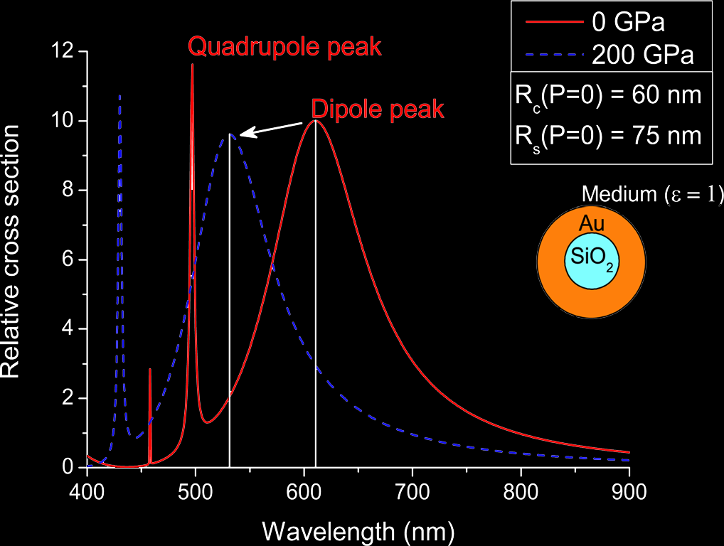
Nanoshells under pressure
Relative cross section:

Slide 15
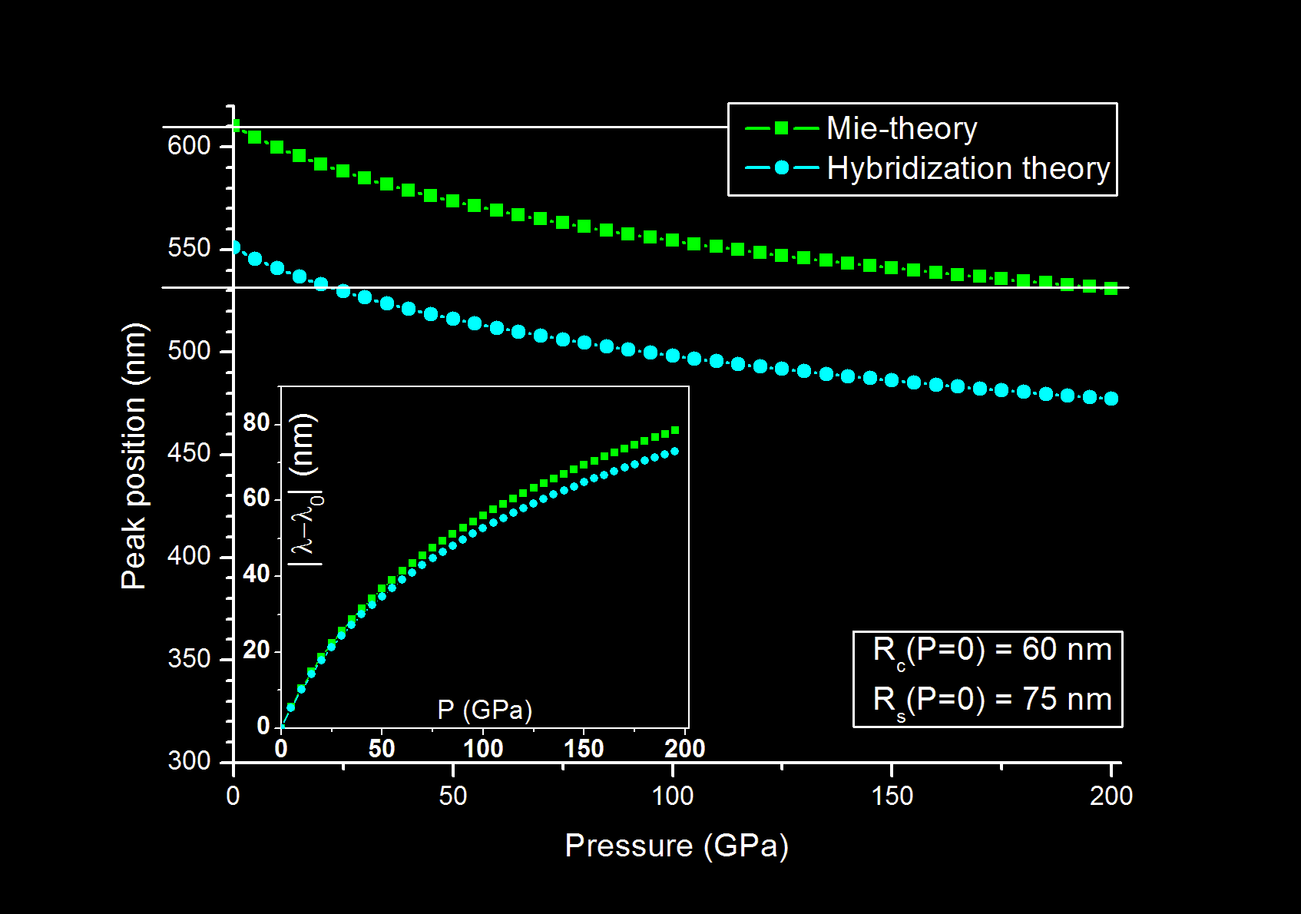
Looking good!
We calculate the peak shift:

Slide 16
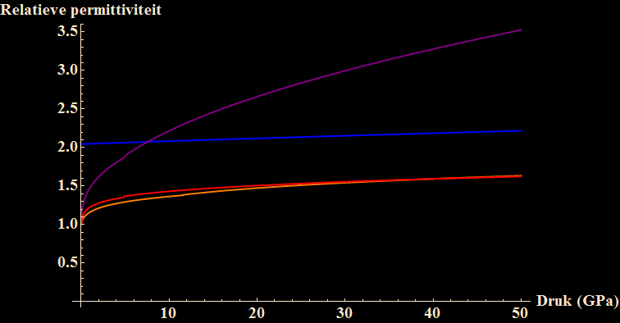
Pressure media
The nanoshell is not in vacuum, but inside a pressure medium.
H₂
SiO₂
Ne
He

Slide 17
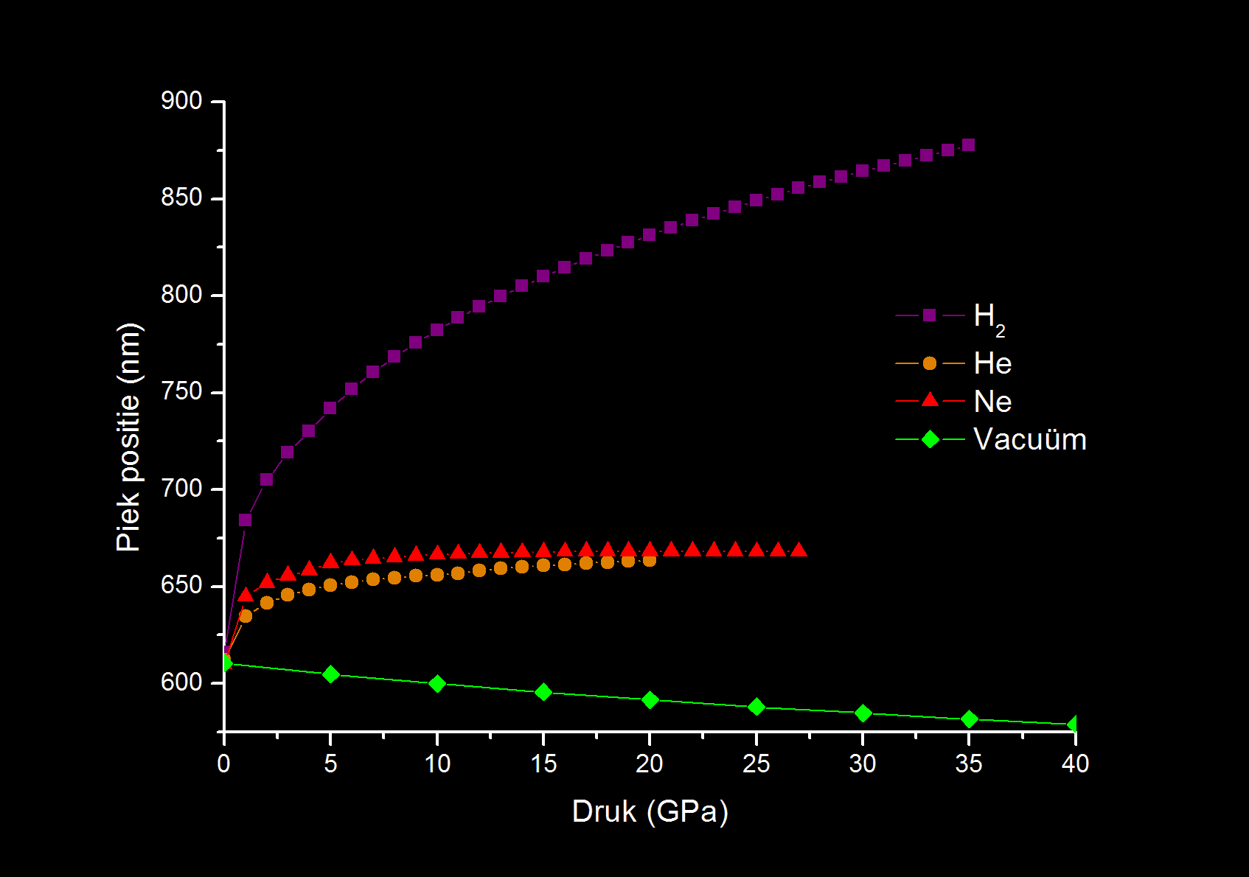
Not so good
The shift changes direction
And seems to stop for He and Ne

Slide 18
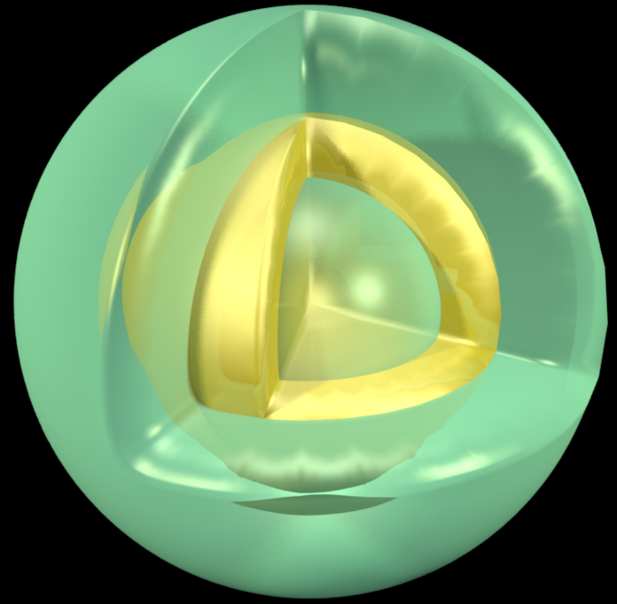
The coated nanoshell (CNS)
Add an extra layer:
  Will shield the influence of the medium
  But leaves the compressiblity
But how thick?
Au
SiO₂

Slide 19
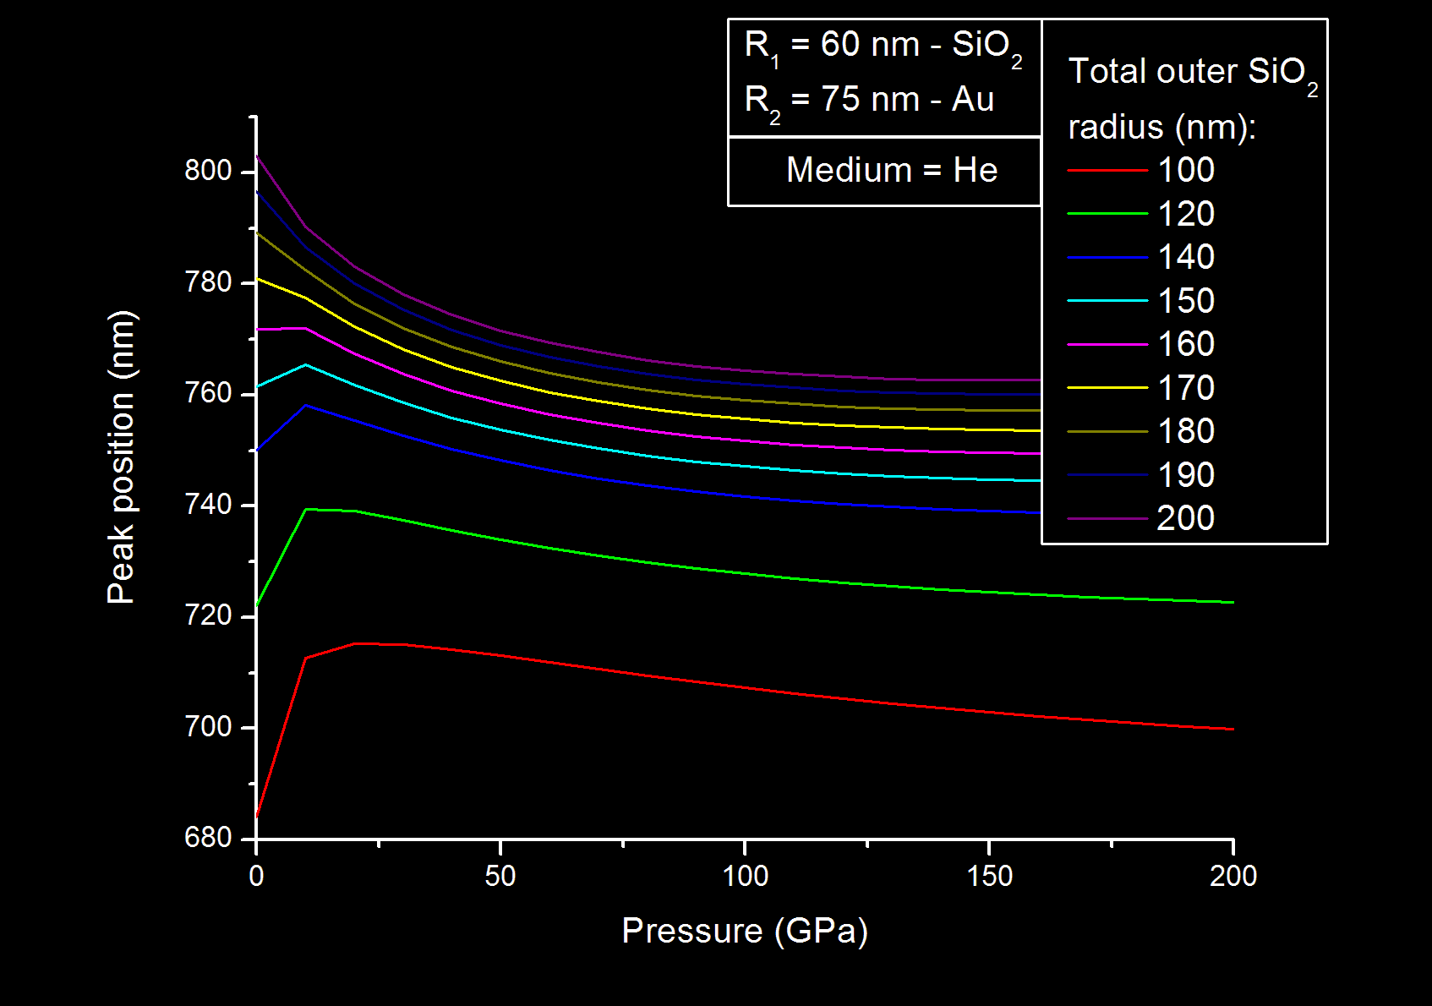
The coated nanoshell
A thick layer is needed!

Slide 20
Theoretical predictions
Average resolution for CNS: 0,90 nm / GPa
Rubies: 0,36 nm/ GPa
Advantages:
  Nanoshells can be tuned to right frequency band
  Are smaller and need less density
Disadvantage:
  Callibration is still needed

Slide 21
Experiments
Page left blank intentionally

Slide 22
Outview
Experimental verification
Finetuning of theory
Heating
Use as biosensor
Sensing of metallic hydrogen

Slide 23
Nanoshells under pressure
Questions?
Published: N. Van den Broeck et al. JAP 110, 114318 (2011)
21 July 2012

Slide 24
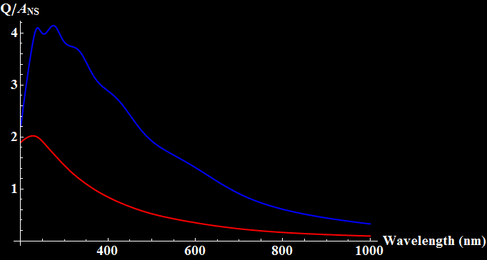
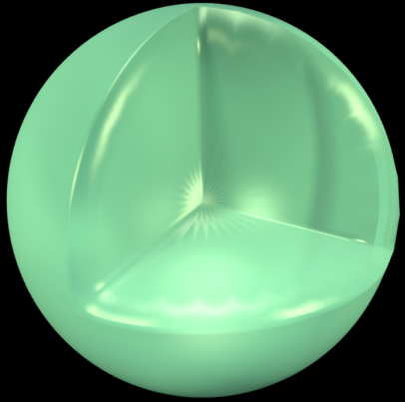
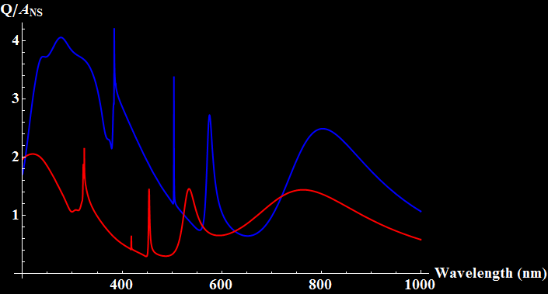

Extra: waarom geen vol SiO₂ bolletje?
R = 200 nm
R₁ = 60 nm
R₂ = 75 nm
R₃ = 200 nm

Slide 25
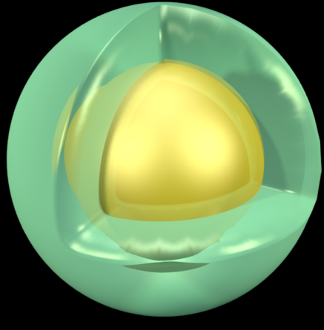
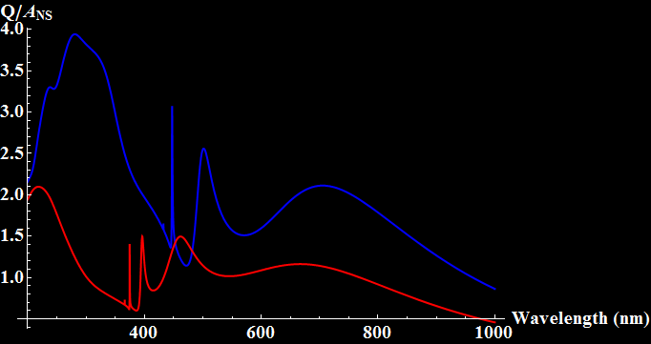
Extra: waarom geen Au kern en dikke SiO₂ schil?
R₁ = 75 nm
R₂ = 200 nm
R₁ = 60 nm
R₂ = 75 nm
R₃ = 200 nm

Slide 26
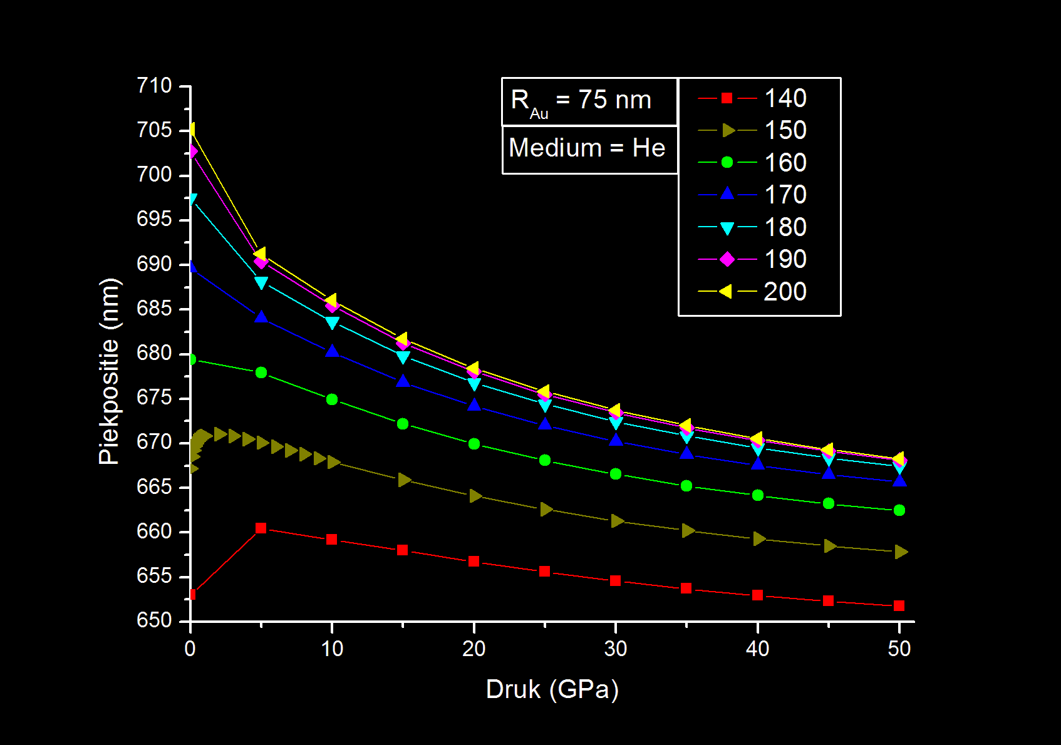
Extra: waarom geen Au kern en dikke SiO₂ schil?

